Slide 1
Classroom Management – Android Client UI Design (UX feedbacks)
Alone, Sandra, Judy
WW43.4, 2011

Slide 2
Feedback Legend
Open/questions
UI/UX issue description
UI/UX improvement recommendations by Intel
General UI/UX issues across application
UI/UX improvement recommendations by Intel
Reference design by Intel

Slide 3
General Guidelines/ Recommendations
Text Description: Simplify the description in dialogs and ensure the text readability on a 7 inch screen with 1024x600 resolution.
Visual Design: The visual design of popup dialogs is too heavy for a simple dialog. Use visually light design – may use Android native dialog style.
Screen Rotation: When Classroom Management UI is active, lock screen at landscape mode. When user get back to OS desktop or other apps, screen rotation should still be workable. If student rotate to portrait mode, teacher will see portrait thumbnail.
Software Keyboard: If text field is covered by software keyboard, the UI should automatically scroll up for user to input (follow Android native behavior).
Back Behavior: User should be able to tap global Back button to go to previous screen within this application. During connecting status, user can tap Back button to cancel connecting.
Quiz Results: Student should be able to view quiz results when connected or offline (see ref design).
Status Notification: Need a notification to indicate student is connected to teacher.

Slide 4
General Opens
File Browser: what’s the native file system structure of Android. We need to deliver a very simple file browser for user to select files.
Received Files:
Where are the received files saved by default? In a fixed application folder or in system library folders according to the file format?
Can user access these received files when he/she is offline?
How can user access them outside of CM application?
File Transfer Behavior: What’s the behavior of file transfer? Can user transfer multiple files at the same time? What’s the transfer sequence? (see File Submission page for details)

Slide 5
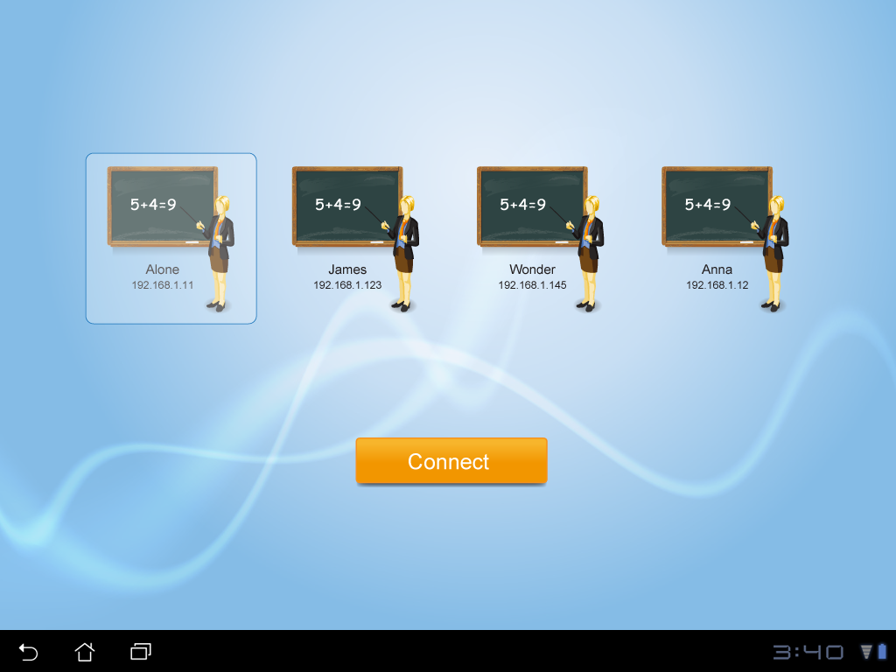
Login – Connect to Class
Add simple instruction in this page.
Show message if there is no teacher available. May need a Refresh button?
User consistent teacher icon as the one at Teacher side.
IP Address needed for both teacher & student? Recommend to remove it for simplicity.
Can student access files received offline?
May need a UI for user to view received files & quiz results if not in a class (see ref design).
Selecting an item & clicking a button is not standard behavior of Android.
Should tap to connect directly.

Slide 6
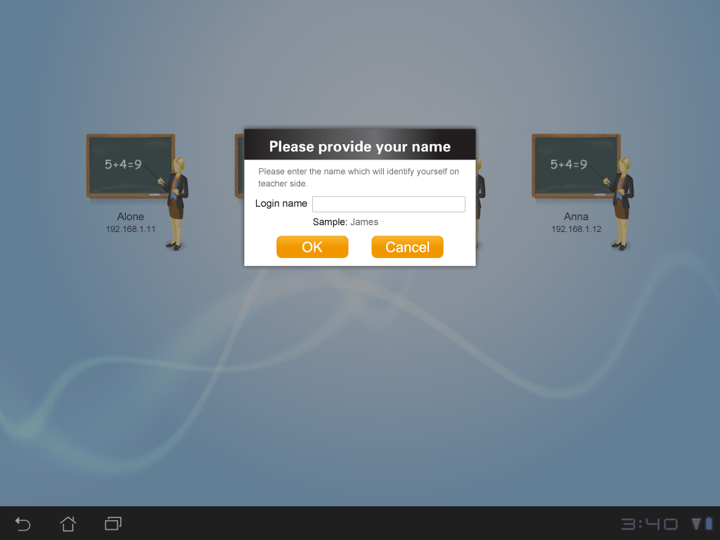
Login – Provide Name
Combine set name & student registration (see feedback on student registration).
Popup window show up at different places.
All pop up window should pop up in the center of the screen.
The visual design is too heavy for a simple dialog.
Use visually light design – may use Android native dialog. (See Ref Design).
Text descriptions are wordy and text are too small.
Simplify the description and enlarge the text. Ensure the text readability on a 7 inch screen with 1024x600 resolution.
Notes:
General:
All pop up window should pop up in the center of the screen.
Enlarge the window for better readability.
If text field is covered by software keyboard, should allow user to scroll the page and access the fields on the bottom.

Slide 7
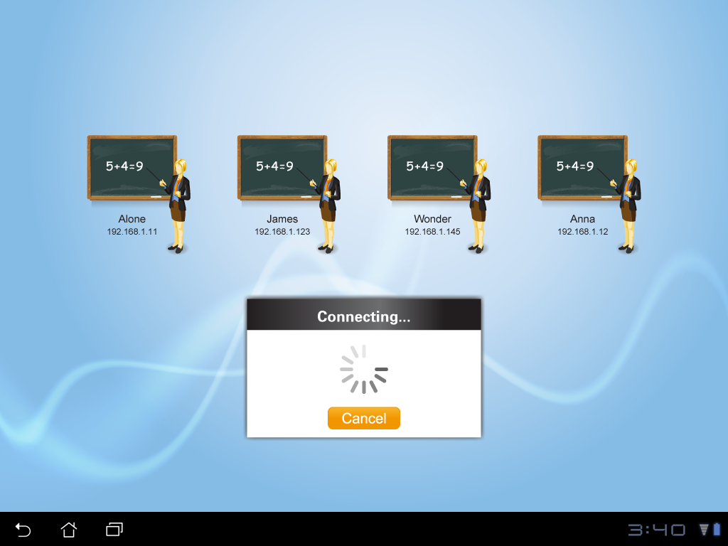
Login - Connecting
User should be able to tap global Back button to cancel connecting as well.
Simplify the graphic design – may use Android native design.

Slide 8
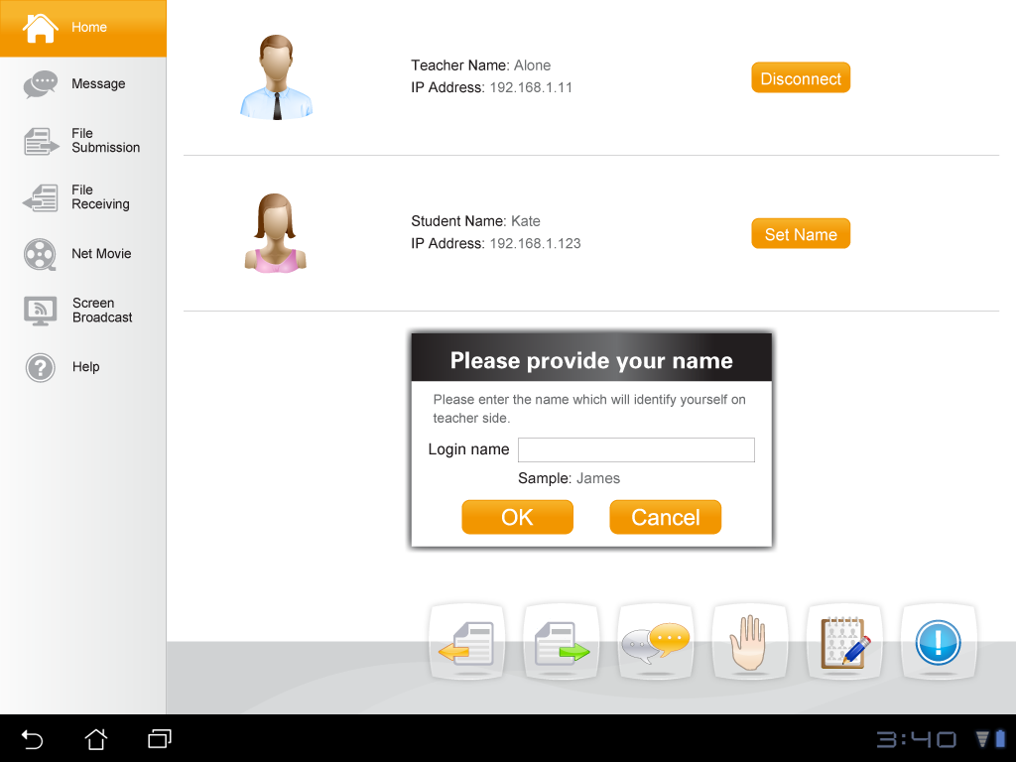
Home
Current set name & registration features are really confusing.
Combine these 2 features and UI.
Remove IP if not necessary.
The icon is too gender specific. Should use more abstract icon for both student & teacher.
Functional buttons should be put on the top and move status to the bottom (see ref design).
Net movie & screen broadcast will never show up at the same time.
Should only show active function tabs on the left panel.
Provide a retract button for user to retract to icon only view.
Put low-profile Help & About buttons together in a corner of the Home page as they are not often used.
Notes:
General:
Current detailed text size (e.g. class name, dialog message, etc.) are too small. Need to ensure the text readability on a 7 inch screen with 1024x600 resolution.
Some buttons/controllers are too small such as the tabs on the left, set name, delete button in file transfer. Need to make sure all the controllers are touch friendly.
Net movie & screen broadcast will never show up at the same time. Should only show active function tabs on the left panel.

Slide 9
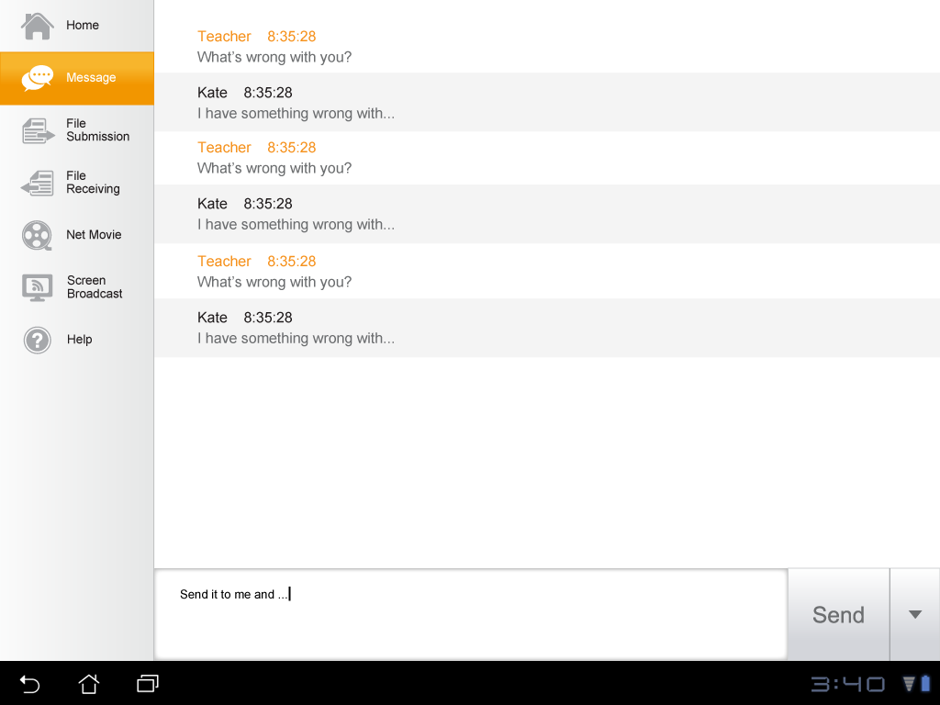
Message
Phase 2
Text input area is too tall, esp. for a 7 inch widescreen.
Reduce the height of the input area .
When software keyboard shows up, the whole page should scroll up for user to access the input area.
Notes:
Reduce the height of the input area and the send button.
When software keyboard shows up, the whole page should scroll up for user to view the input area.

Slide 10
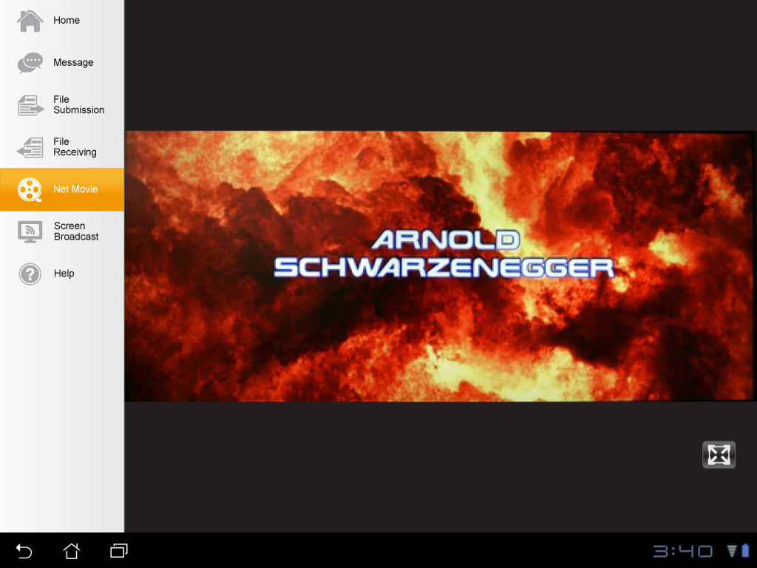
Net Movie / Screen Broadcast
Phase 2
Change the name to “Movie Broadcast”.
Improve the full screen button design and enlarge the button size.
Put it either on the top right or bottom right of the screen (follow windows design)
Notes:
Improve & enlarge the full screen button design and put if either on the top right or bottom right of the screen (follow windows design)

Slide 11
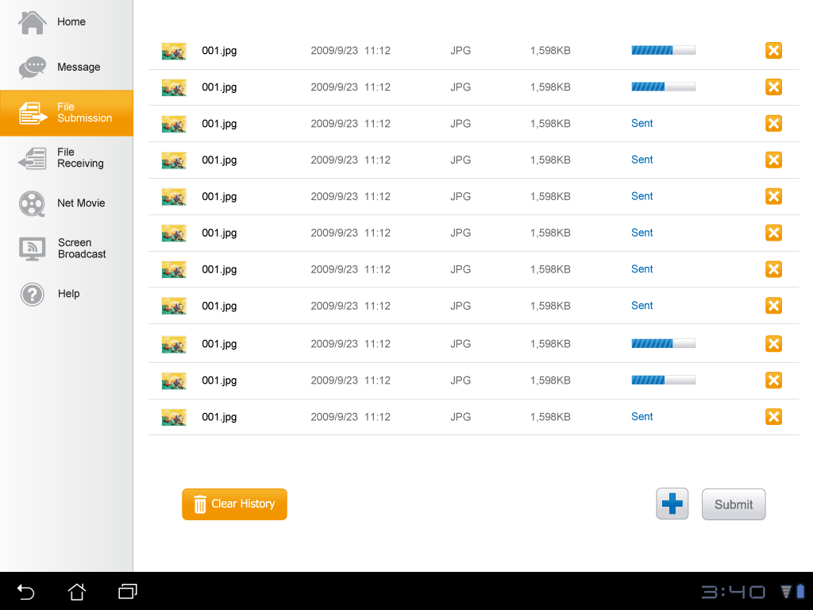
File Submission
Multiple files can be submitted at the same time?
Some buttons/controllers are too small.
Make sure that all buttons/controllers are touch friendly on a 7 inch screen with 1024x600 resolution.
The newly added files should be put on the bottom.
Remove file format which is not needed.
Use 2 line design for better touch and enlarge the progress bar.
Allow user to sort the file list by file name, type, submitted time (see ref design).
Move the buttons to the top.
Remove Clear History if file submission is only for this class.
Pop up file browser? Select a file to add to the list? Is multiple selection allowed?
Or user can directly select a file and send? Only show status in the page.
Notes:
General: Texts & buttons are too small.
The files should be sorted by transferred time? Latest on the top. Then why some on the bottom are still being transferred?

Slide 12
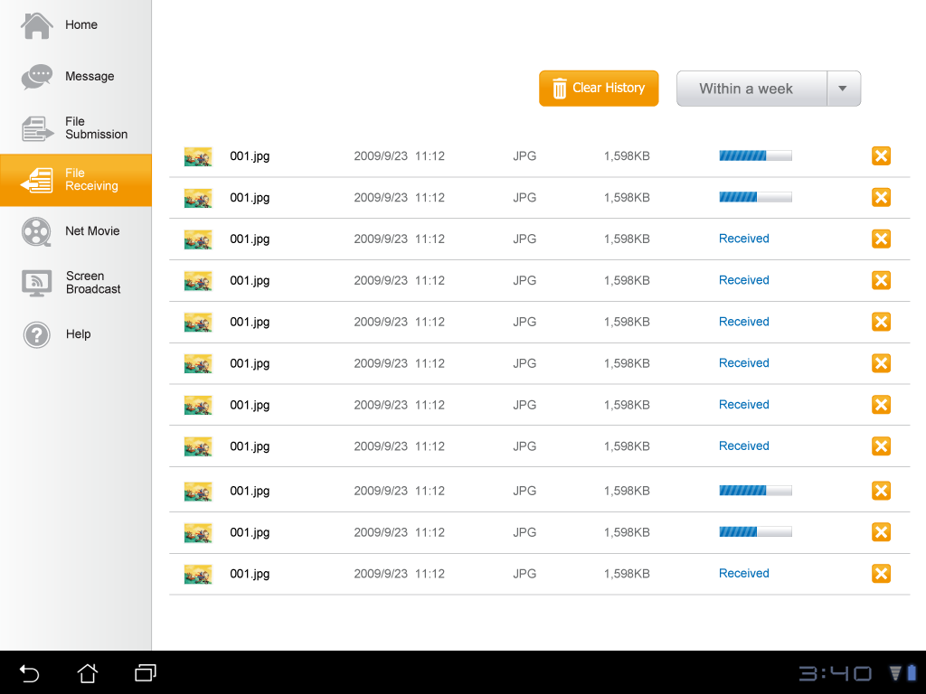
File Receiving
Keep the consistency of UI layout between file submission & receiving. (See ref design)
If user clear history, where to view the files? Shall we provide a Open Folder button?
Can student remove the file that is being received?
Tap a line to open the file? E.g. click a image to open photo viewer? Can use get back by the global Back button?
Allow user to sort the file list by file name, type, received time, teacher. (See ref design)
Notes:
The button layout are different between File Submission & Receiving pages.

Slide 13
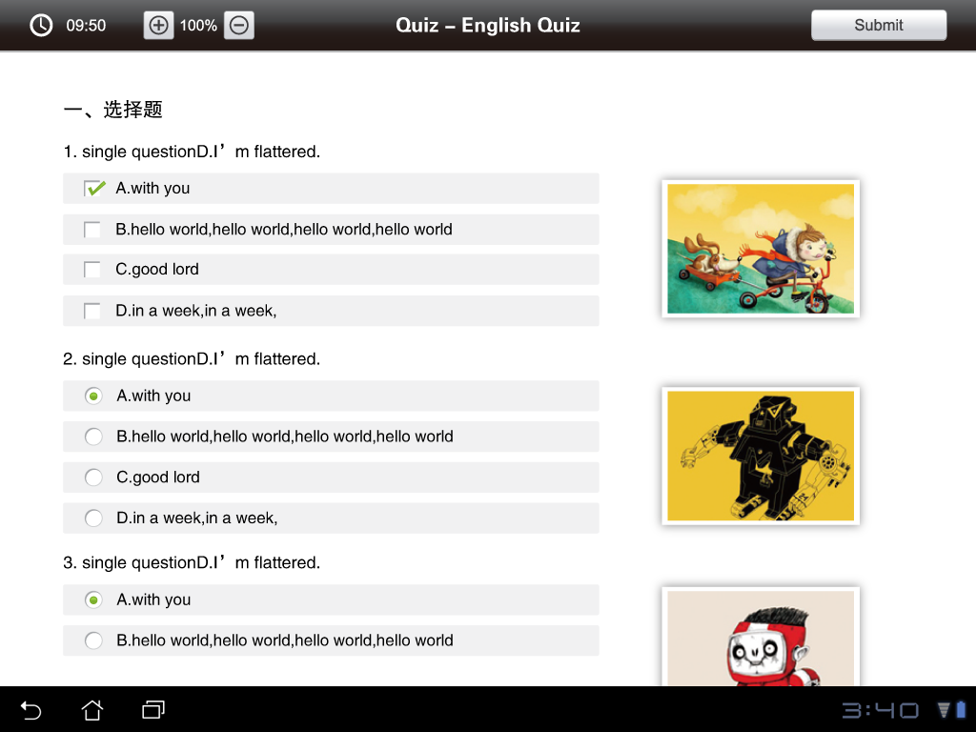
Quiz
Zoom in/out buttons little small and too obvious.
Use low profile graphic design and enlarge the button for easier touch.
Controllers (checkbox, radio button, etc.) are too small for touch.
Enlarge the controllers and allow user to tap the whole item to select.
Need UI for student to view test results. (See ref design).
Notes:
Controllers (checkbox, radio button, etc.) are too small for touch. Should enlarge the controllers and allow user to tap the whole item to select.
The zoom in & out buttons are too small.

Slide 14
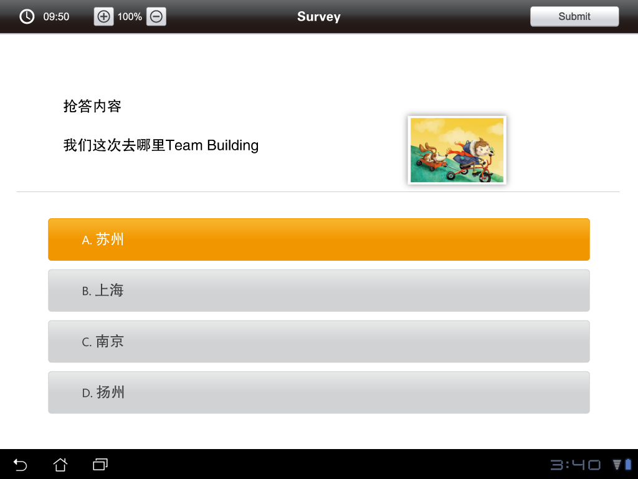
Survey

Slide 15
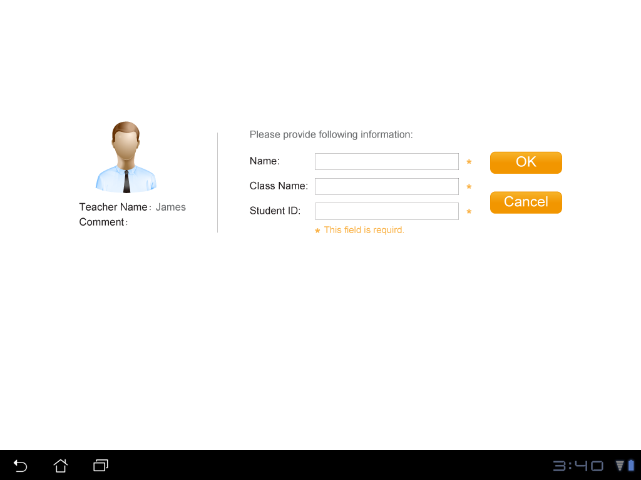
Register
Phase 2
Current set name & registration features are really confusing.
Combine these 2 features and UI. These student information should be visible at teacher side for teacher to better identify the student (see ref design).
Notes:
The screen has too much white space. Need refinement on the graphic. Or make is a pop up window?

Slide 16
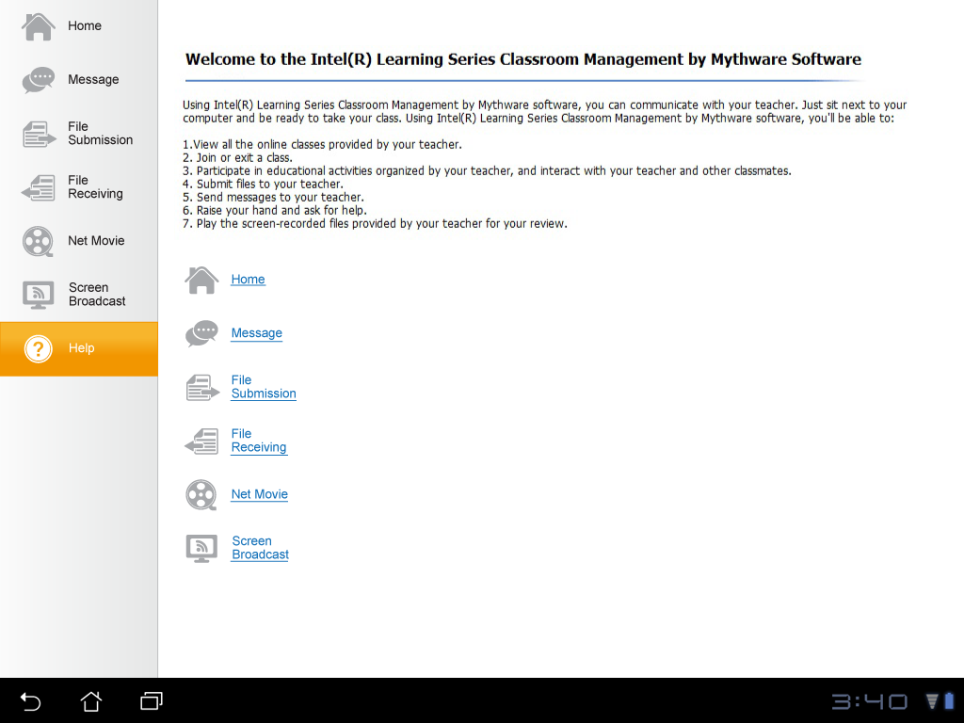
Help
Help document format (text font & size, page layout, etc.) need to be improved.
Notes:
Help document layout need to be improved.

Slide 17
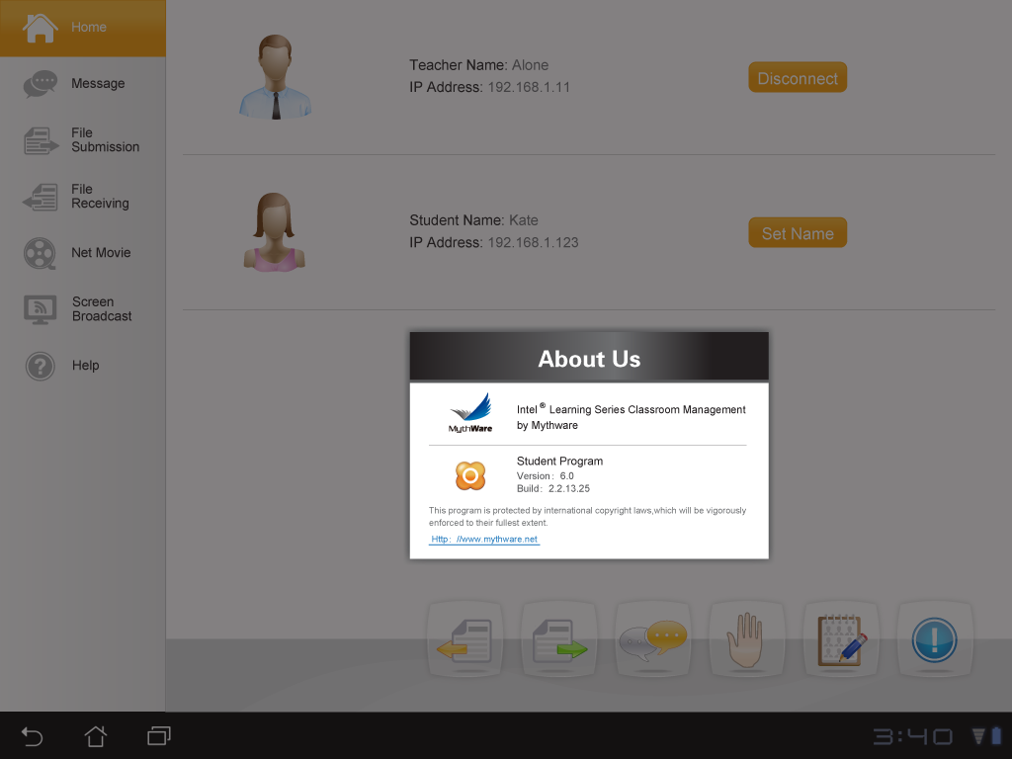
About
Should follow Intel(R) Learning Series About format and ensure the text readability.

Slide 18
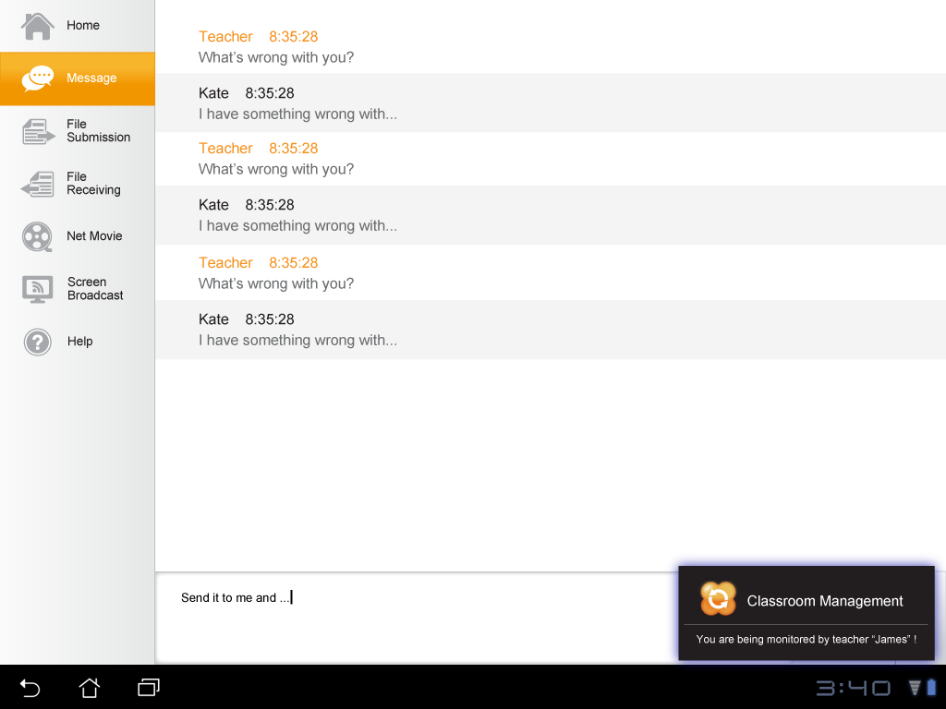
Monitor
Title bar too tall. Once the balloon is dismissed, user won’t know the status.
Use Android native balloon style.
Show a intuitive notification icon on the bottom bar when the student is being monitored/demoed. Student can click it to view corresponding message.
Notes:
Message is too small to read and the title bar looks much heavier than the message.

Slide 19
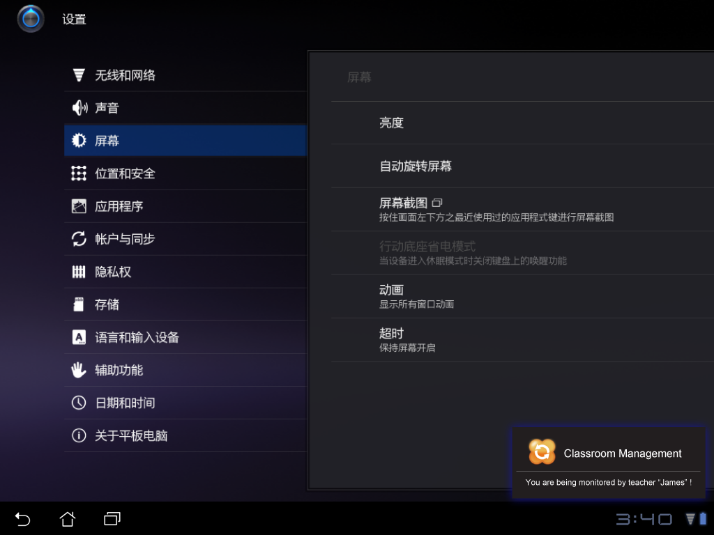
Demonstration
The message is same as screen monitor, which is confusing.
Should use specific message for student demo.
Notes:
The message is same as screen monitor which is confusing. Should use more appropriate message for student demostration.

Slide 20
Reference Design Note: The graphic design in the following slides should be designed by Mythware to be consistent within the app as well as with the android OS.
Notes:
The message is same as screen monitor which is confusing. Should use more appropriate message for student demostration.

Slide 21
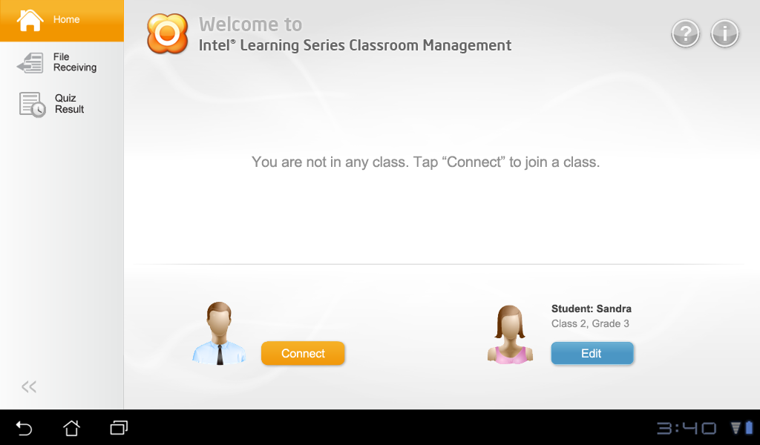
Reference Design – Home Page (Not Connected)
Allow user to view received files & quiz results offline.
Allow user change user info offline (for shared usage).
When user launch CM, he/she will enter Home page (offline mode).
Tap Connect to enter select teacher UI.

Slide 22
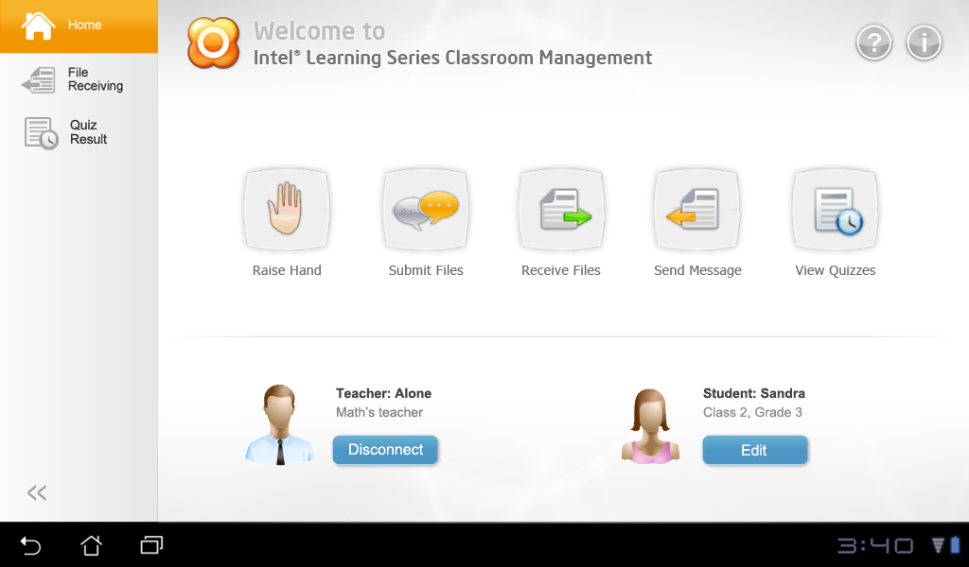
Reference Design – Home Page (Connected)
Move Help & About buttons here. Tap Help to open a new screen; tap About to pop up About dialog.
Improve the layout of Home page.
Combine set user name, class & student ID together.
Change to “Edit” for user to edit all user information.
Provide a retract button for user to retract to icon only view.

Slide 23
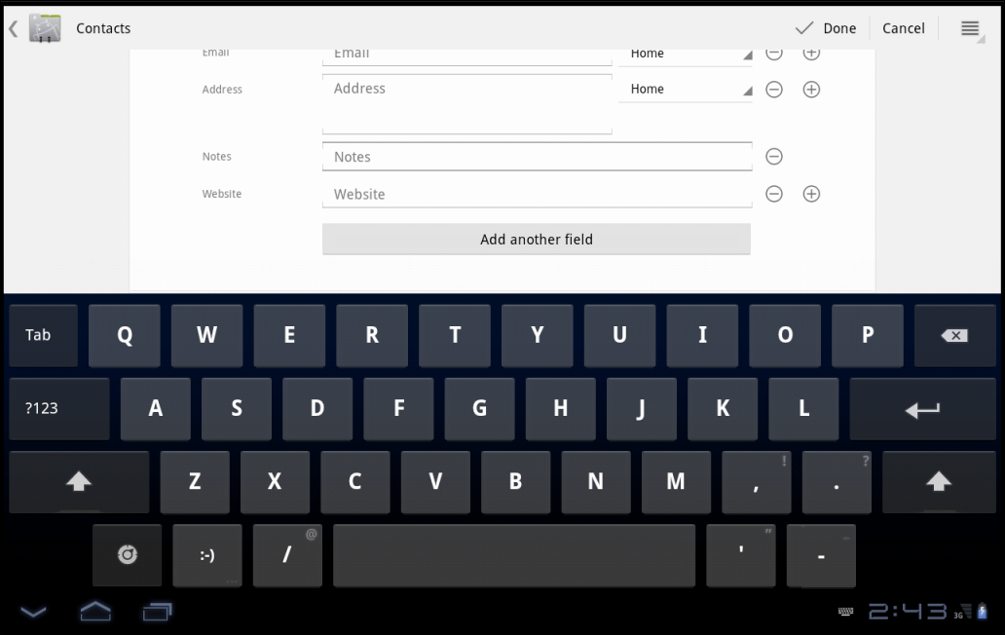
Reference Design – Student Registration
Combine Set Name & Register features. These info should be visible at teacher side (e.g. when teacher hover on a student thumbnail).
Enter your information
* Name:
Class:
Student ID:
OK Cancel

Slide 24
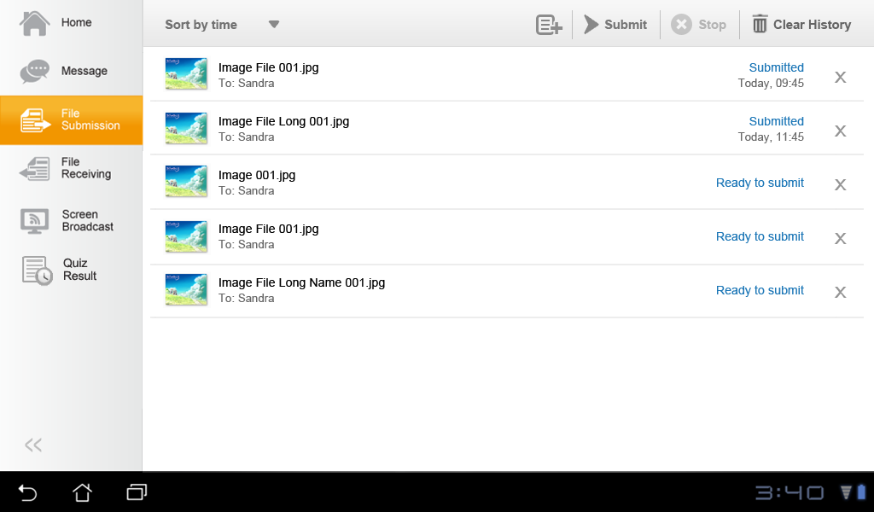
Reference Design – File Submission (Ready to Submit)
Move the buttons to top & improve the layout.
Allow user to sort the file list by file name, type, submitted time. Sort by time by default (latest on the bottom)
Use 2 line for 1 file item (Android style).
Change “Pending” (to be submitted) to “Ready to submit”.

Slide 25
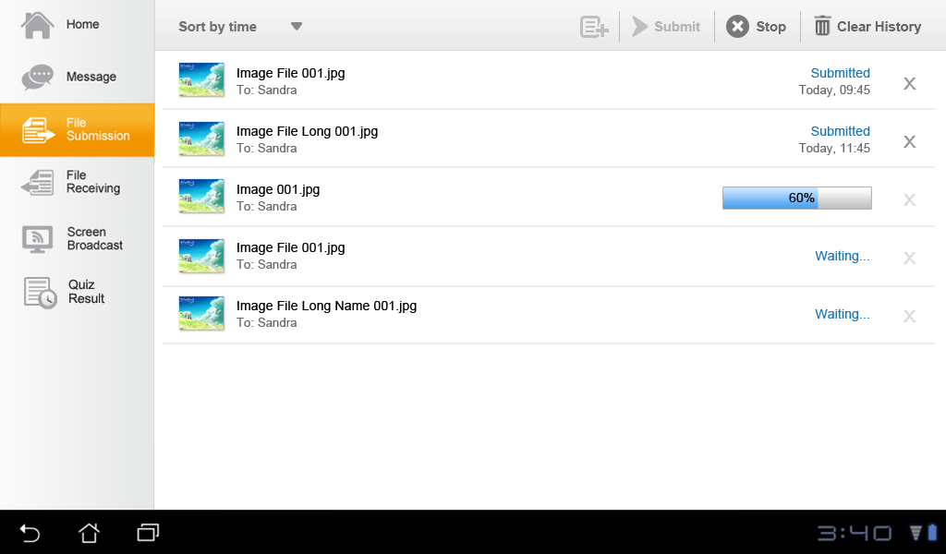
Reference Design – File Submission (Submitting…)
Change “Pending” (waiting in queue) to “Waiting”.

Slide 26
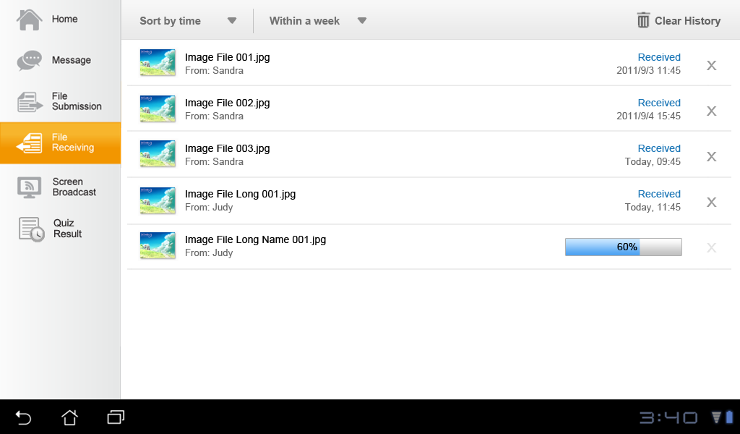
Reference Design – File Receiving
Add teacher info for user to know who sent these files.
Allow user to sort the file list by file name, type, received time, teacher. Sort by time by default (latest on the bottom)

Slide 27
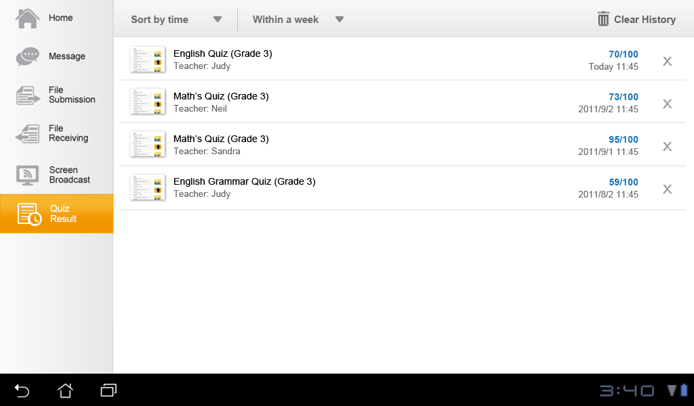
Reference Design – Quiz Result
Allow user to sort the quiz list by quiz name, quiz complete time, teacher, quiz score. Sort by time by default (latest on the TOP).
Add “Quiz Result” main tab for user to view test results sent by teacher.

